Slide 1
Sarcasm Detection
jiren ren
Leqi liu

Slide 2
Task
Great, my flight has been cancelled.
(sarcastic, the actual emotion is negative)
This movie is really good!
(non sarcastic, positive emotion)
Sarcasm is an implicit expression that often has a true meaning opposite to its surface meaning, making sentiment analysis and text comprehension more complex.
Sarcasm Detection aims to automatically identify sarcastic expressions in text, distinguishing between truly positive emotions and sarcastic expressions.
Improving the ability of NLP models to understand sarcasm can help improve reasoning about implicit information and enhance adaptability to areas such as sarcastic literature and humour analysis.

Slide 3
Dataset
Ghosh Sarcasm Detection Dataset (Magnets for Sarcasm: Making Sarcasm Detection Timely, Contextual and Very Personal (Ghosh & Veale, EMNLP 2017))
Crawled from the Twittersphere, using a user’s self-declaration of sarcasm as a retrieval cue (#sarcasm, #sarcastic, #yeahright, etc.).
Train Set |  | Test Set
Sarcastic | Non-sarcastic | Sarcastic | Non-sarcastic
24,453 | 26,736 | 1,419 | 2,323

Slide 4
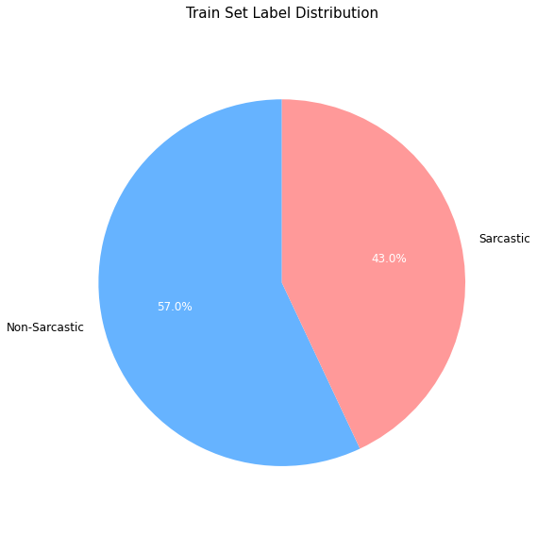
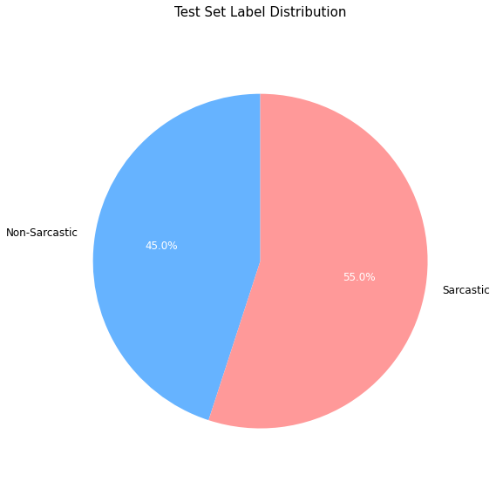
Dataset Visualization: Data Balancing

Slide 5
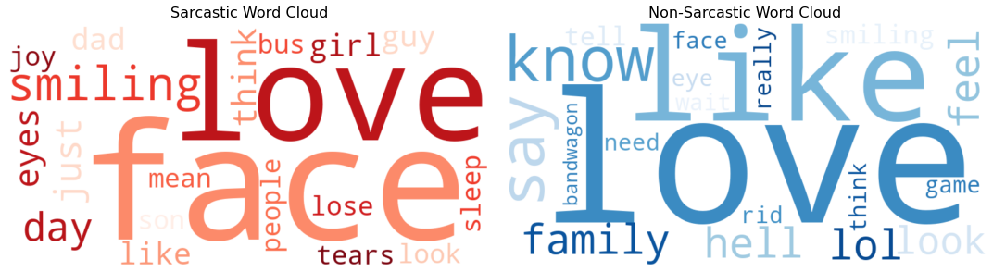
Dataset Visualization: High Frequency Words
without stopwords:

Slide 6
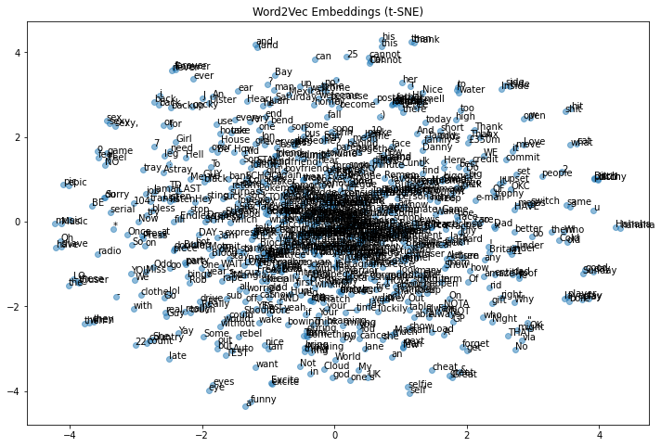
Dataset Visualization:
Not separated very well, that’s
why LSTM performances better

Slide 7
Model
Feature-based machine learning models | Deep learning models
TF-IDF + SVM | skip-gram + fasttext + CNN + LSTM

Slide 8
Metrics
Confusion matrix
4 classical classification metrics:
Precision
Recall
Accuracy
F1 Score
Log loss

Slide 9
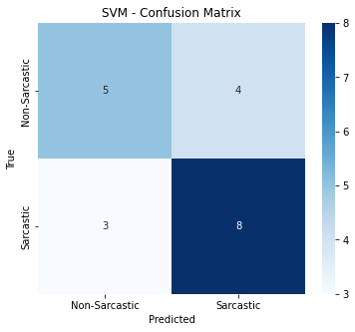
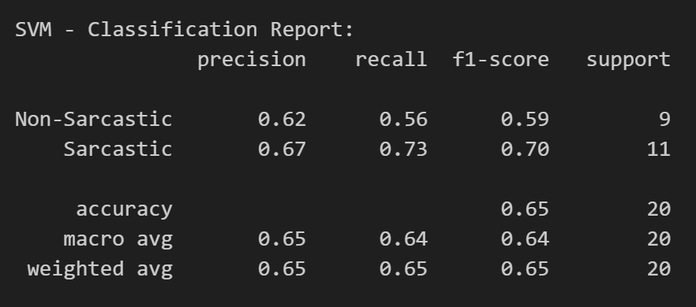
Result: SVM model
more false positives.

Slide 10
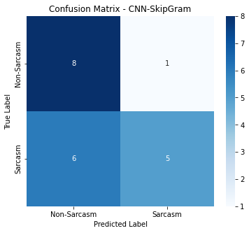
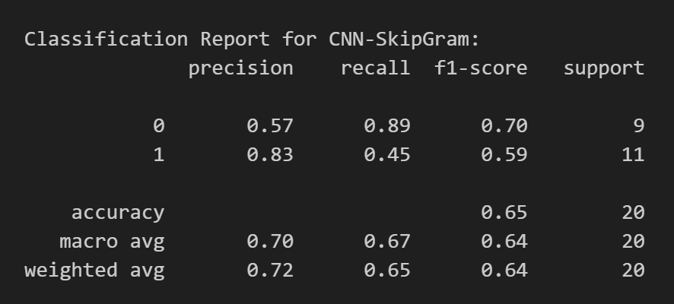
Result: CNN skip-gram model
missing many actual positive cases
Weaker performance

Slide 11
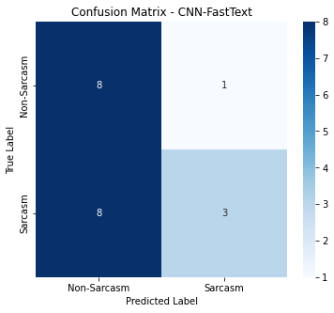
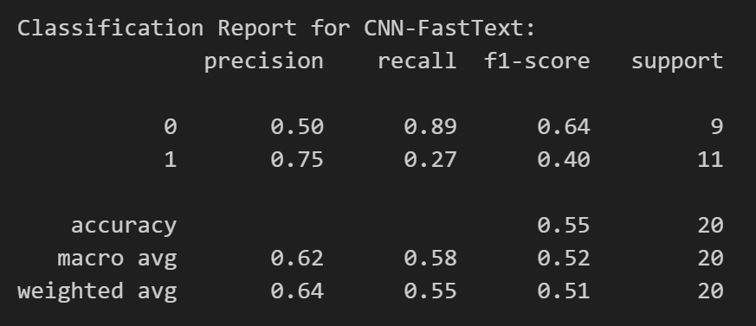
Result: CNN fasttext model
more false positives.
missing many actual positive cases
weaker performance

Slide 12
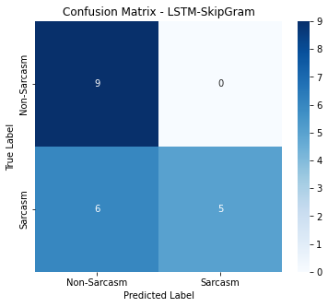
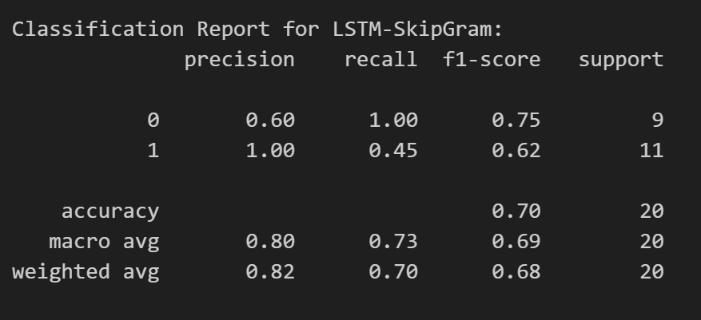
Result: LSTM skip-gram model

Slide 13
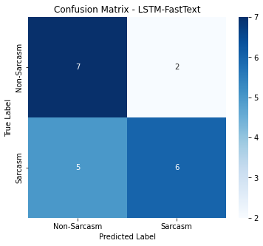
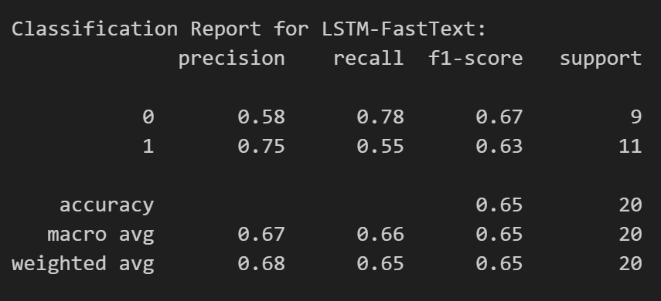
Result: LSTM fasttext model

Slide 14
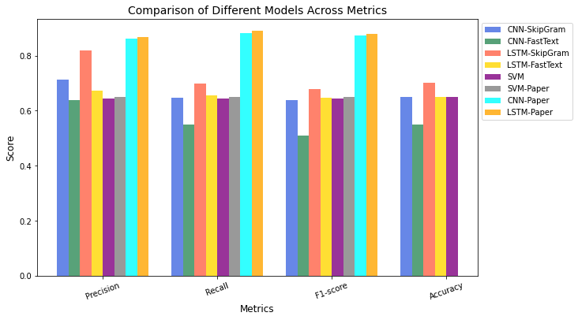
Result: Comparison
LSTM models perform the best
CNN models show mixed results: paper is better
SVM models perform moderately: paper is better too

Slide 15
Conclusion & Future work
This project explored sarcasm detection using SVM, CNN, and LSTM with SkipGram and FastText embeddings. LSTM performed best in capturing sarcasm’s context, while FastText handled rare words well. Despite good results, challenges remain in detecting complex sarcasm.
Future work could explore Transformers, BERT, ensemble methods, multilingual detection, richer contextual features, diverse datasets, and multimodal data like images or audio.

Slide 16
Reference
Aniruddha Ghosh and Tony Veale. 2017. Magnets for Sarcasm: Making Sarcasm Detection Timely, Contextual and Very Personal. In Proceedings of the 2017 Conference on Empirical Methods in Natural Language Processing, pages 482–491, Copenhagen, Denmark. Association for Computational Linguistics.
Ghosh, A., & Veale, D. T. 2016. Fracking Sarcasm using Neural Network. Proceedings of the 7th Workshop on Computational Approaches to Subjectivity, Sentiment and Social Media Analysis, pages 161–169, San Diego, California. Association for Computational Linguistics.
Hochreiter, S., & Schmidhuber, J. 1997. Long shortterm memory Neural computation 9(8):1735-1780.
Kreuz, R., & Caucci, G. 2007. Lexical Influences on the Perception of Sarcasm. In Proceedings of the Workshop on Computational Approaches to Figurative Language, pages 1–4, Rochester, New York. Association for Computational Linguistics.
Burfoot, C., & Baldwin, T. 2009. Automatic Satire Detection: Are You Having a Laugh?. In Proceedings of the ACL-IJCNLP 2009 Conference Short Papers, pages 161–164, Suntec, Singapore. Association for Computational Linguistics.
Tungthamthiti, P., Shirai, K., & Mohd, M. 2014. Recognition of Sarcasms in Tweets Based on Concept Level Sentiment Analysis and Supervised Learning Approaches. Pacific Asia Conference on Language, Information and Computation,

